Slide 1
Fake and Real News Detection

Slide 2
Project Name
Fake and Real News Detection
Team Name
Anuja Berad
Deepika Tiwari
Finaz Nadaf
Mayur Chavhan

Slide 3
Business Problem Statement
This dataset consists of about 40000 articles consisting of fake as well as real news. Our aim is train our model so that it can correctly predict whether a given piece of news is real or fake. The fake and real news data is given in two separate datasets with each dataset consisting around 20000 articles each.
Objectives
1 Need to classify the fake and real news accurately.
Architecture level analysis:
2. Data transformation/Text processing using R/Python
3. Need to get sentiments Analysis and n-gram analysis with some charts like histogram,
Density plot, Bar plot, pie-plot etc.
4. Deployment through R Shiny or Flask/ Stream lit

Slide 4
Agenda for our Goal Achievement
Text Pre-Processing
Tokenization
Stopwords
Stemming
Lemmatization
Text Representation
Exploratory Data Analysis
Features Engineering
Model Building
Model Evaluation
Model deployment

Slide 5
Tools and Technical Parameters
Software
Libraries
Models
Deployment
Python
Jupiter
Notebook or
Google
Colab
Pandas
NumPy
Seaborn
Scikit-learn
Spacy
Nltk
Word cloud
gensim
Logistic Regression
Random Forest
SVM
Naïve Bayes
StreamLit

Slide 6
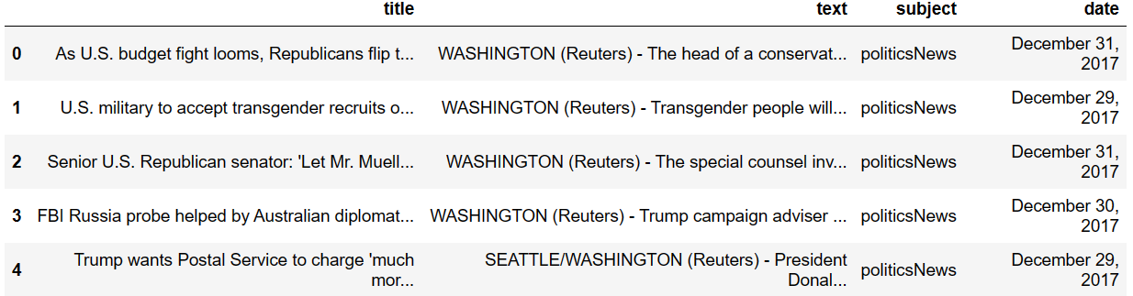
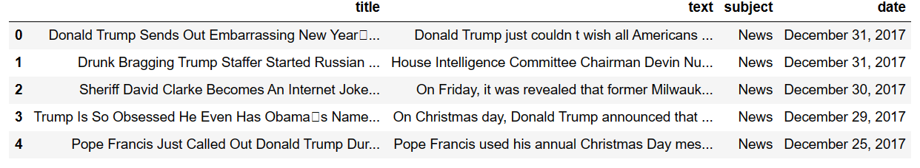
Data Set Details
Real News
Fake News

Slide 7
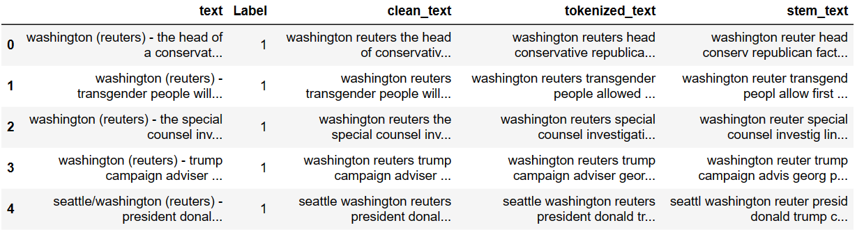
Merged Data

Slide 8
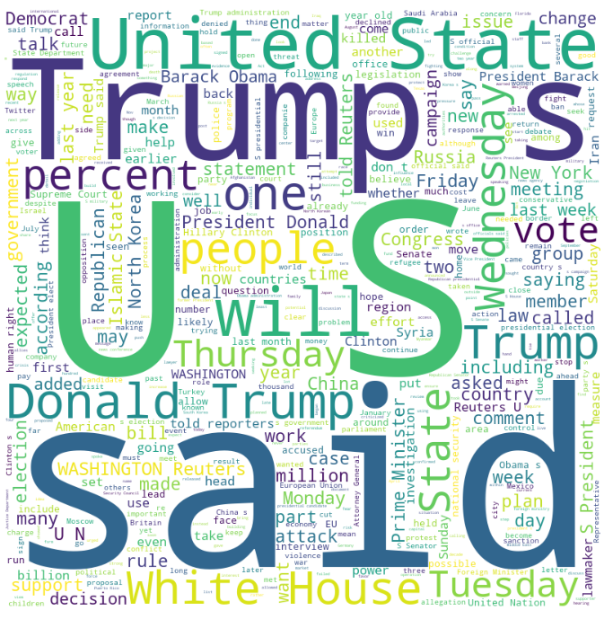
Exploratory Data Analysis
Fake News Analysis-wordcloud

Slide 9
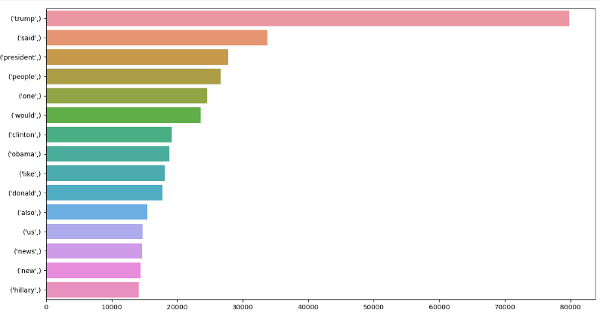
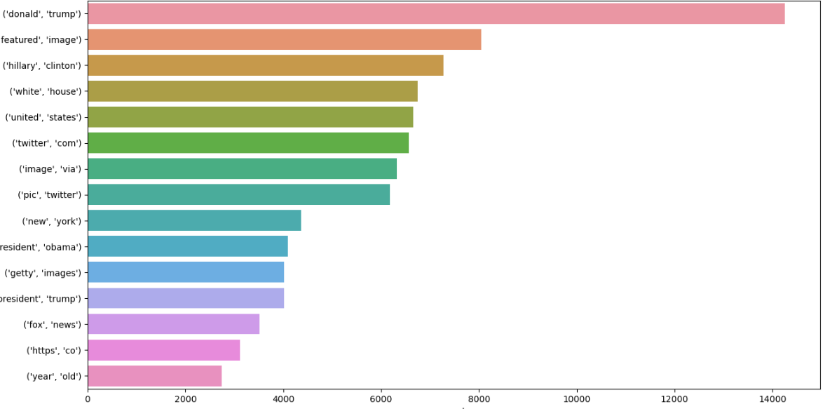
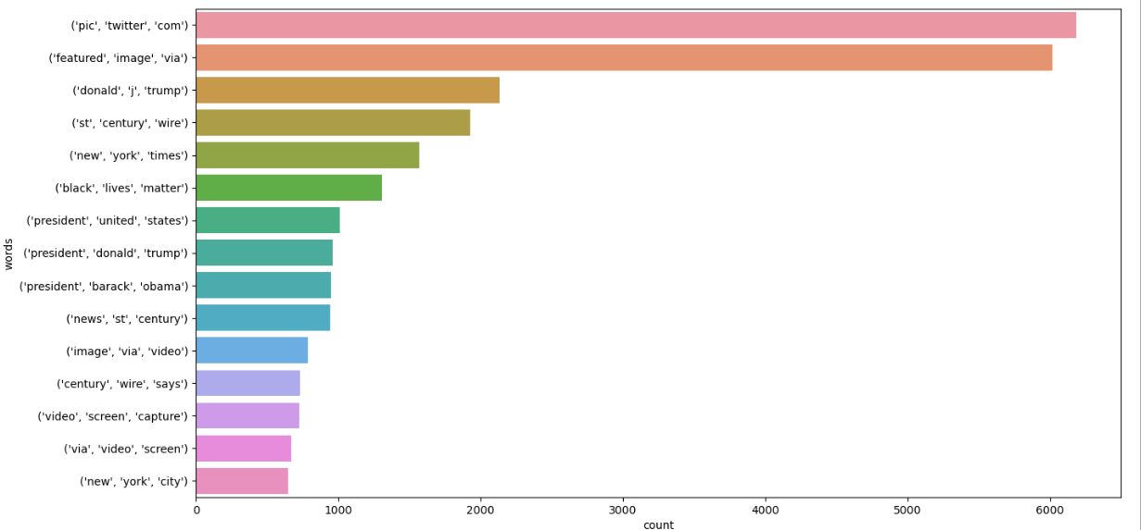
N-Grams
Unigrams
Bigrams
Trigrams

Slide 10
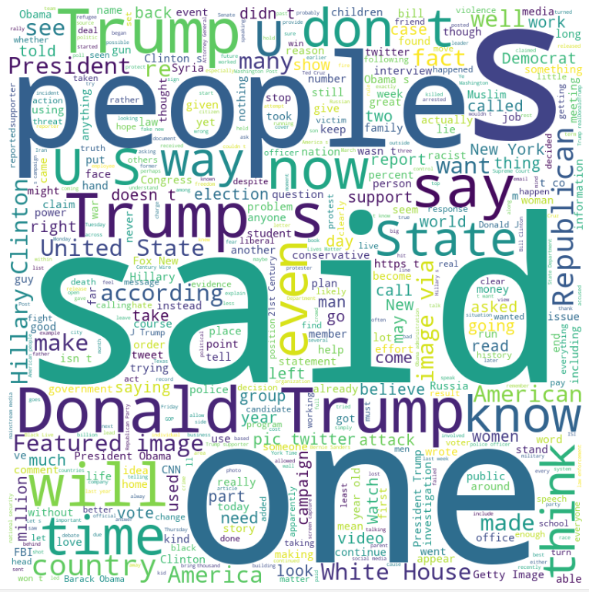
Real News Analysis
word cloud

Slide 11
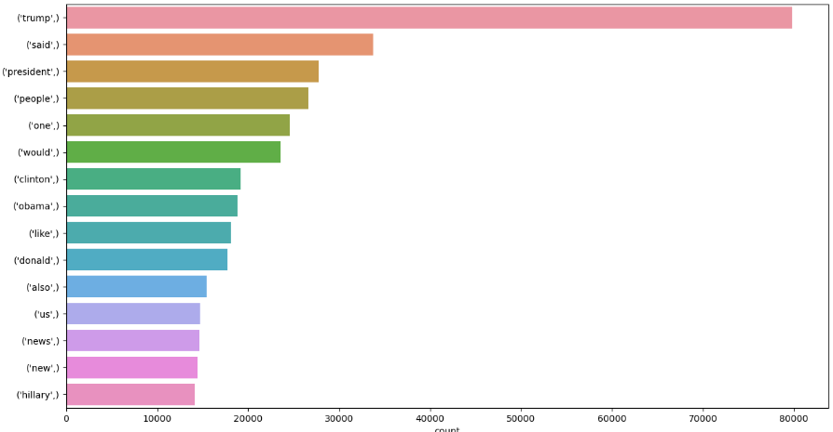
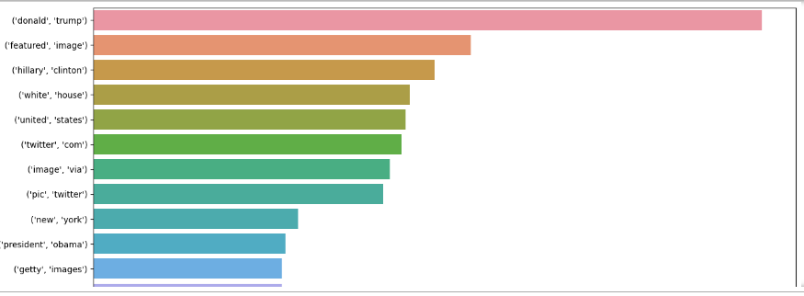
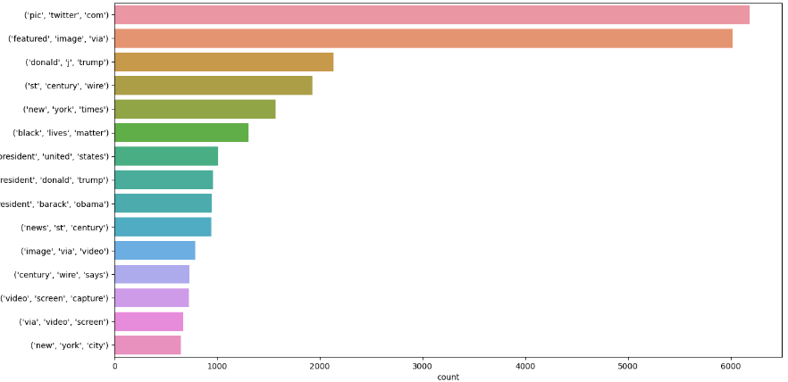
N-grams
Unigrams
Bigrams
Trigrams

Slide 12
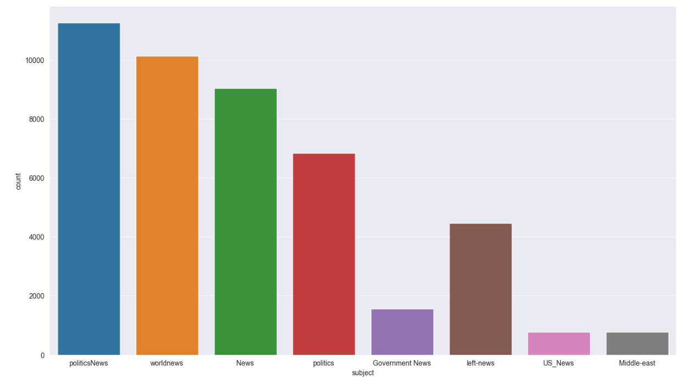
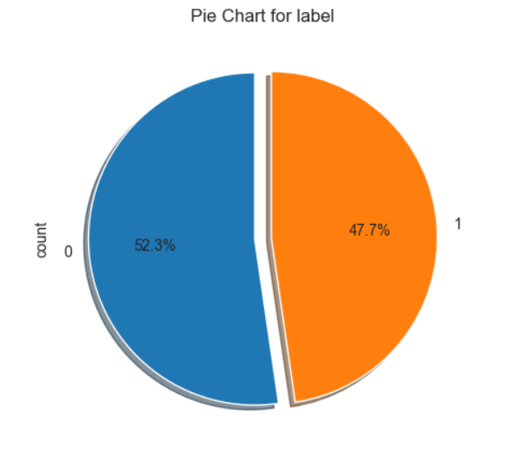
After merged analysis

Slide 13
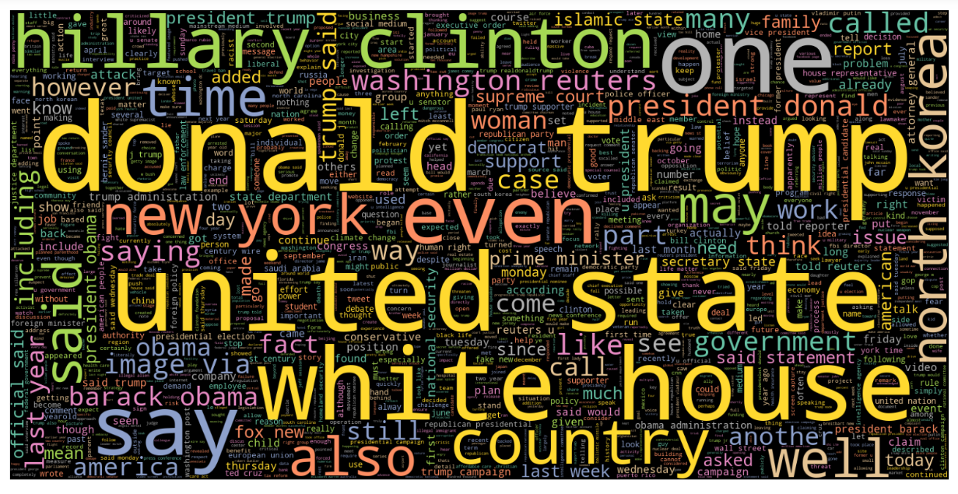
Word cloud after merged data

Slide 14
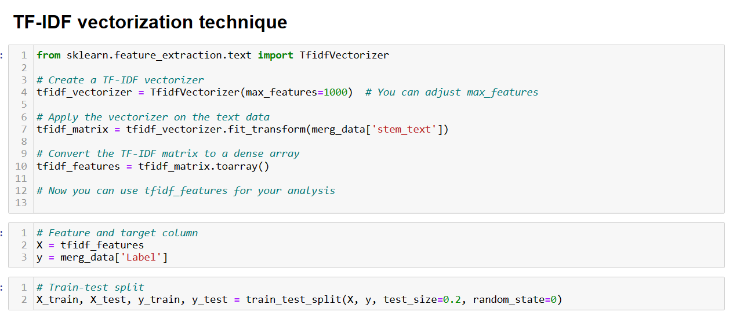
Feature Engineering

Slide 15
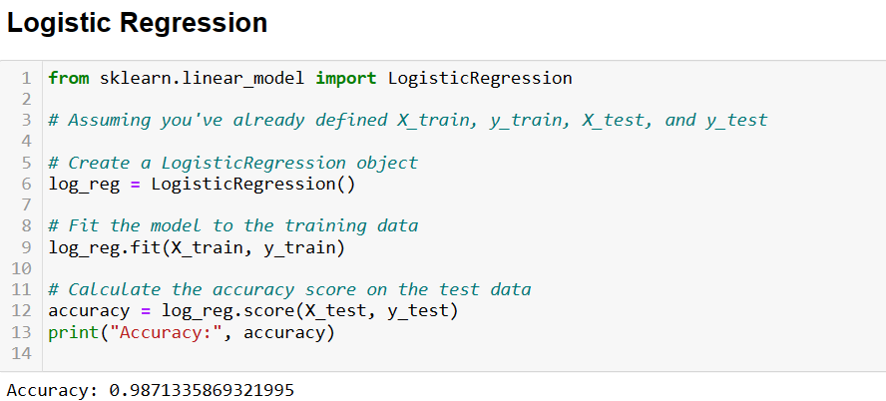
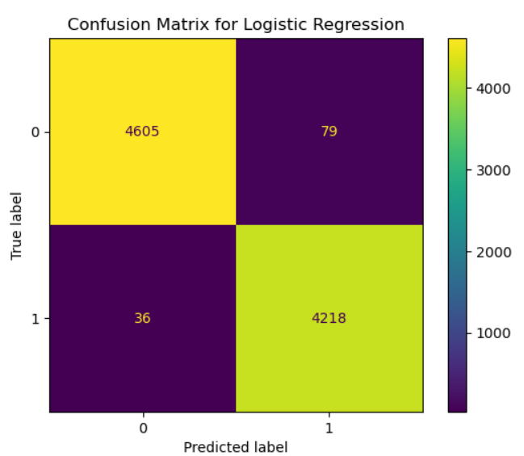
Model Building Algorithms and Selection
Logistic Regression
Random forest
Naïve Bayes
SVM
All the above we are used to find out best model

Slide 16
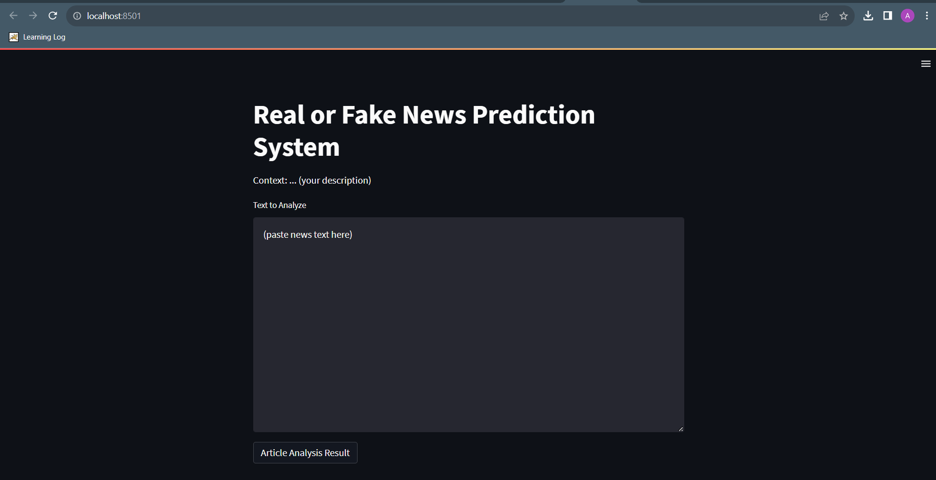
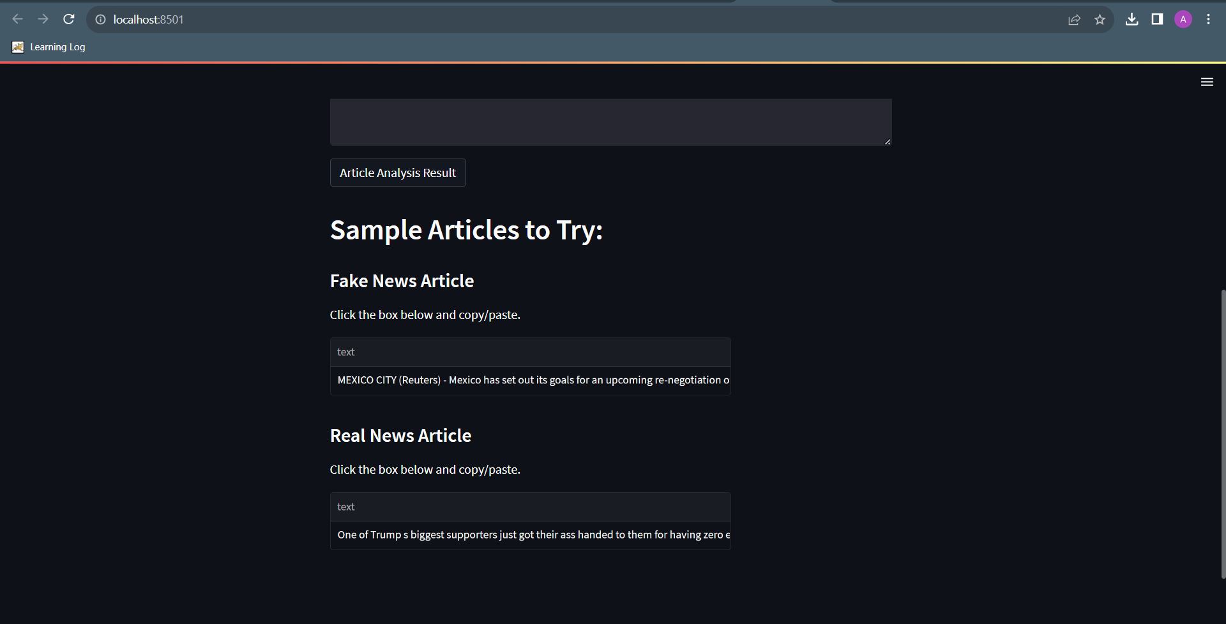
Deployment

Slide 17
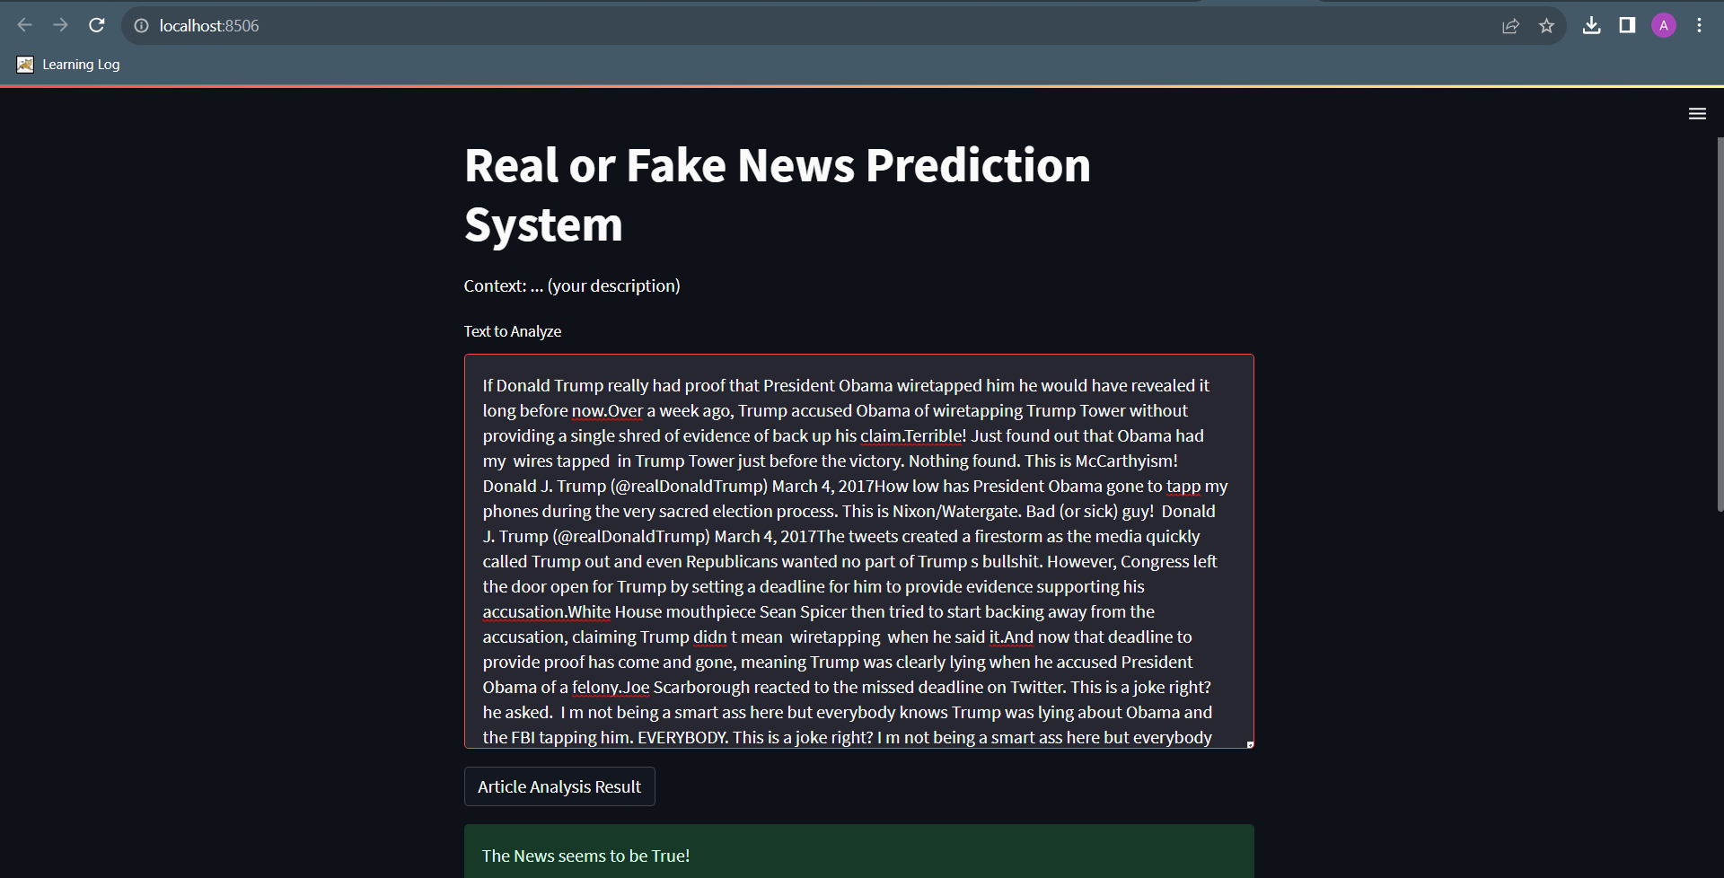
Real

Slide 18
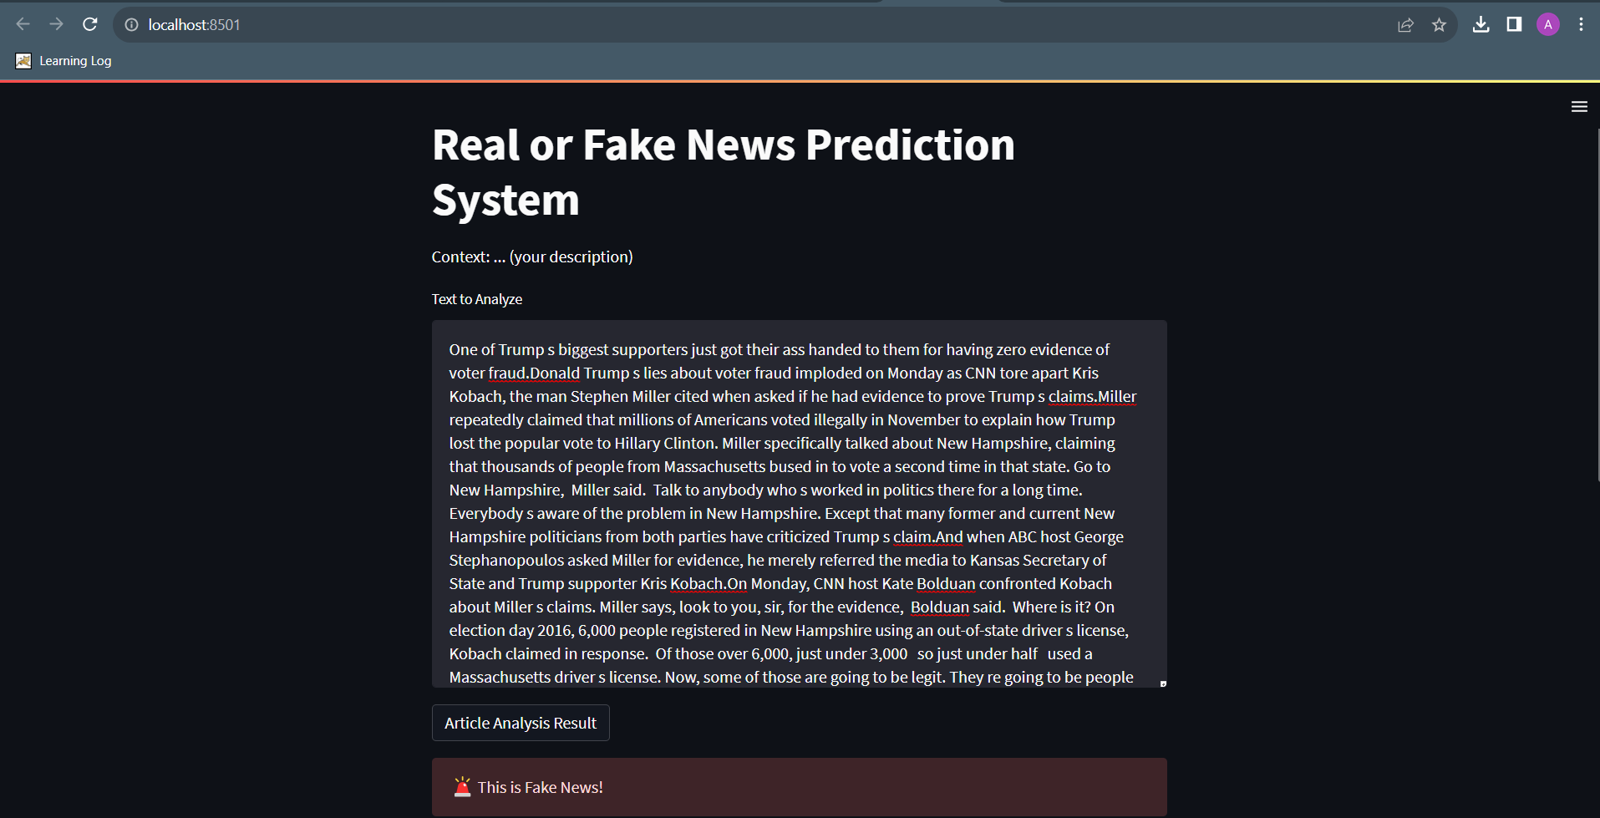
Fake

Slide 19
Conclusion
The rise of fake news has become a global problem that even major companies are facing the challenges to solve it.
It can be difficult to determine whether the is factual without additional content and human judgment.
NLP models can detect the topics and the facts of the news articles, then classify the same as same trustworthy articles and compare the given articles topic with the trustworthy articles.

Slide 20
Thank you

